Slide 1
Latent Damage and Reliability in Semiconductor Devices
May1625 - Advisor & Client: Dr. Randy Geiger
Sean Santella Hayle Olson David Ackerman Jaehyuk Han
12/07/15
Notes:
Hayle

Slide 2
Imagine for a moment...
Chicago: Big rough city. 911 calling center is critically important. Quite a bit of investment in an insanely reliable system.
A lightning storm comes one day, and power goes out. Normally it’s fine, because they have back-ups. But it ended up failing. Their UPS burned out due to a microcontroller failure. Mass chaos in the city.
Afterward, the company who made the system went in and performed a standard repair procedure: swapping out boards until it works again.
But if Latent damage exists, then the non-replaced boards could fail much sooner than expected.
Notes:
David

Slide 3
What is Latent Damage?
Latent Damage:
Is usually caused by an Electrostatic Discharge (ESD) event
Physically damages a device
But is electrically undetectable
Reduces the lifetime of the device
This is the theoretical definition of Latent Damage.
Notes:
Hayle
ESD can actually cause catastrophic failure

Slide 4
Does Latent Damage exist?
Some studies show evidence for the existence of Latent Damage, while others don’t.
As it stands now, Latent Damage is an ongoing topic of study.
Specifically, we care about Commercial off-the-Shelf (COTS) parts.
If it exists, it will reduce the overall lifetime of COTS devices.
Notes:
Jaehyuk

Slide 5
Why should we care?
It has huge implications on Industry, as well as society as a whole.
If it does exist, COTS devices might not be as reliable as the specifications describe.
Unexpected failures increase the cost of repairs on a system.
Latent damage can lead to profit loss.
Notes:
Jaehyuk
Reliability and safety concerns in Industry

Slide 6
Hypothesis
If an ESD event occurs on a semiconductor device, then latent damage exists.
This latent damage can cause the reliability of these devices to decrease.
Resulting in the Mean Time to Failure (MTTF) to be shorter than the manufacturing specifications.
Notes:
Hayle

Slide 7
Overall Project Plan
An experiment with three parts:
Stressing devices
Burn-in testing
Data analysis
Some existing work has already been done on this topic here at Iowa State.
To stay within time and budget constraints we attempted to use/repurpose the existing Printed Circuit Boards (PCBs).
ESD Stress
Accelerate Lifetime
Data Analysis
Notes:
Hayle

Slide 8
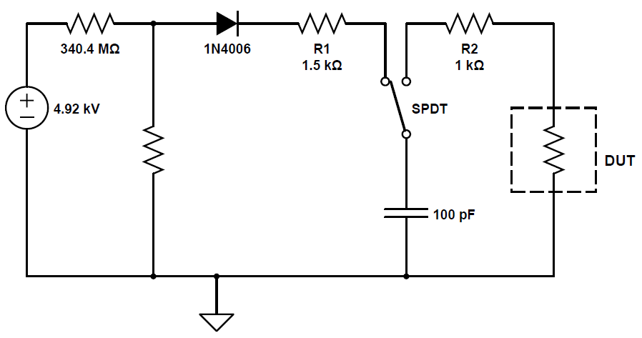
Stressing Devices
----------------------------------------------------------------------------------------------------------------------------------------------------------------
General Procedure
Devices will be exposed to an ESD event at a high-voltage level
Human Body Model (HBM)
100pF Capacitor charged to a high-voltage
Discharged into Device Under-Test (DUT) with the output tied-low
Texas Instruments (CD4049UBE)
6 CMOS inverters on one chip (hex inverter)
Through experimentation, determine a maximum stress level (high-voltage)
Notes:
Sean

Slide 9
Stressing Board
-------------------------------------------------------------------------------------------------------------------------------------------------
Existing Work
An ESD Stress PCB was previously created
Simulate an ESD event
Functionality check
Programmable high-voltage source was non-functional
Re-purposed the PCB to use an agriculturally purposed high-voltage source
Notes:
Sean

Slide 10
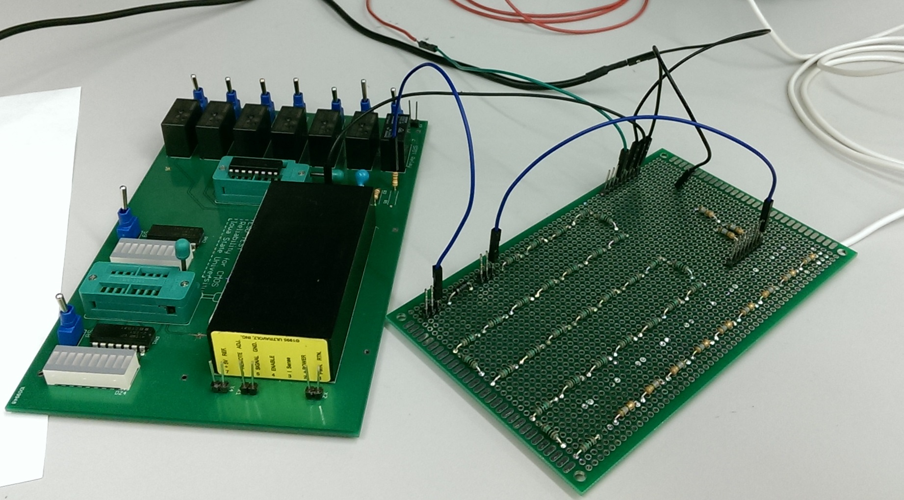
ESD Stress Setup
Charge/Discharge to DUT
HV Stepped Down
HV Input
DUT
Voltage Divider
Notes:
Sean

Slide 11
Burn-in Testing & Oven
---------------------------------------------------------------------------------------------------------------------------------------------------------------------------------------------------------------
General Procedure
Once the parts are stressed, they are put into a burn-in oven.
The burn-in oven is used to accelerate the lifetime of the parts.
While the parts are in the burn-in oven, they’ll be conducting current.
These parts will be measured regularly during procedure, to record their lifetime.
Notes:
Hayle

Slide 12
Burn-in Boards
------------------------------------------------------------------------------------------------------------------------------------
Existing Work
10 boards from previous work used for burn-in testing
9 boards are populated with the parts in the testing set-up (next slide)
Each board has 12 testing set-ups, one set-up for each part to test.
Serious issues make these boards unusable for our purposes (to be discussed.)
Notes:
Hayle

Slide 13
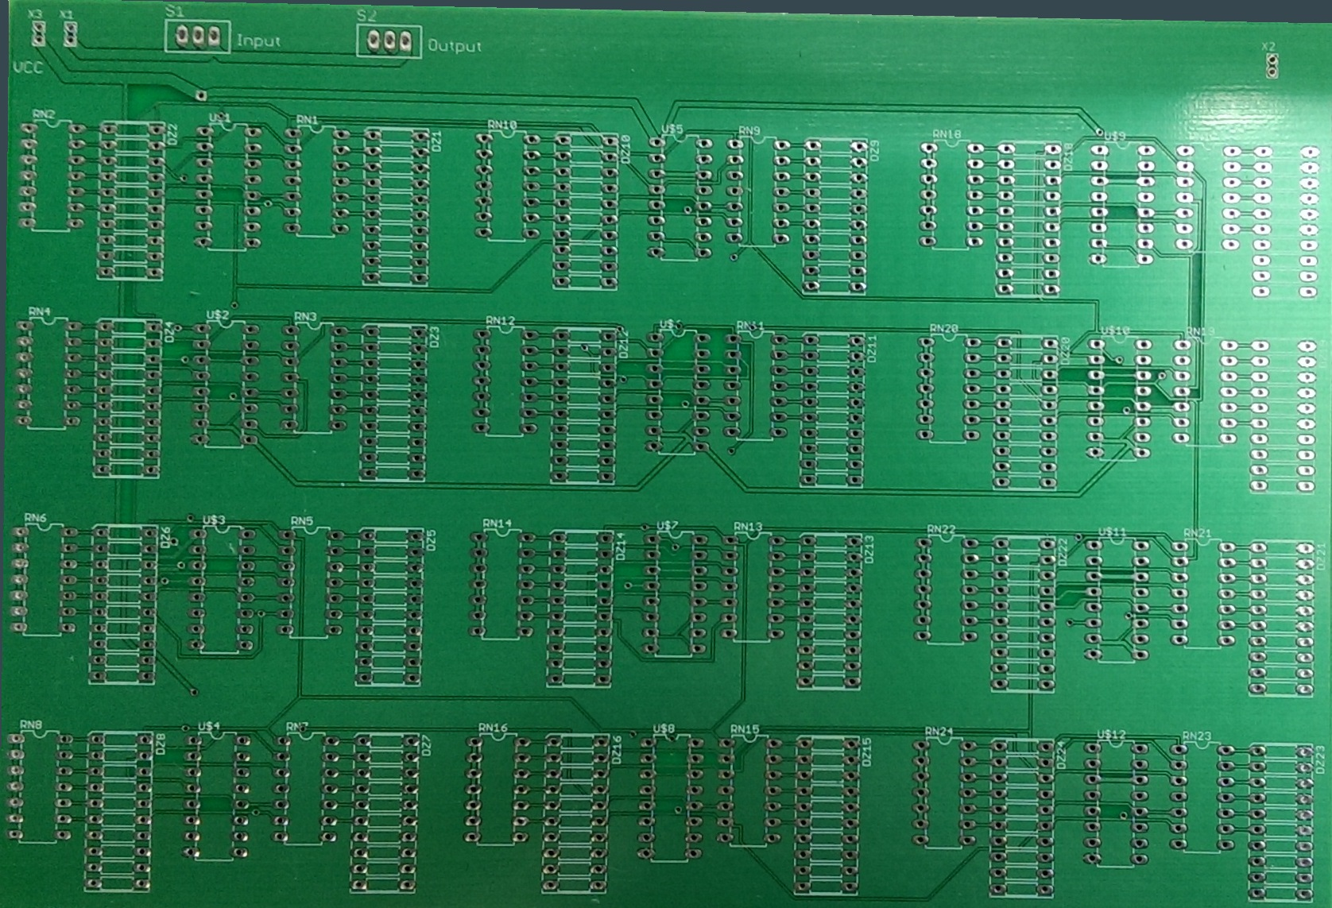
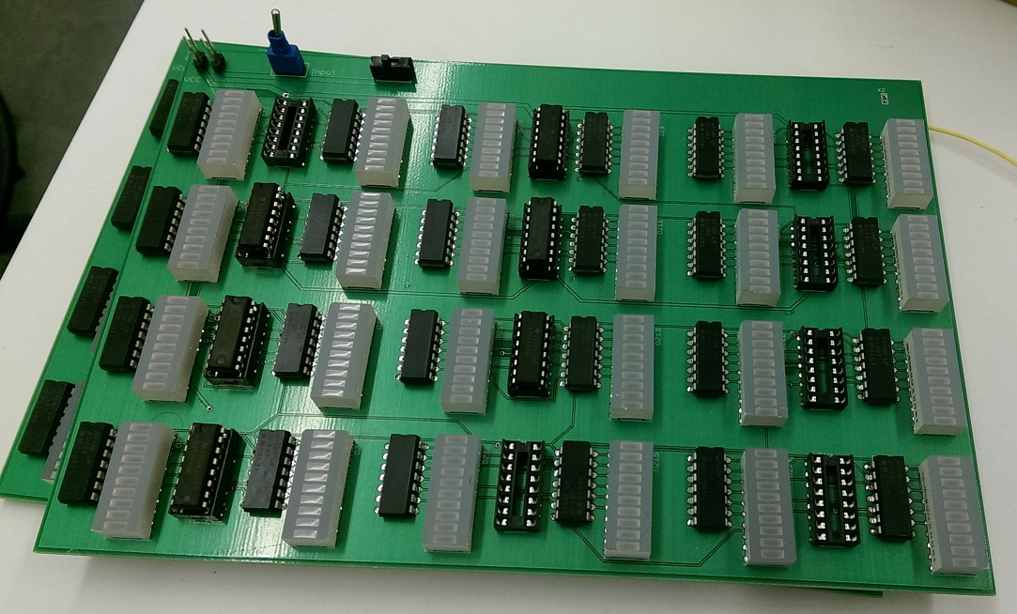
Burn-in Boards
------------------------------------------------------------------------------------------------------------------------------------
Existing Work
1 Testing Set-up
Notes:
Hayle

Slide 14
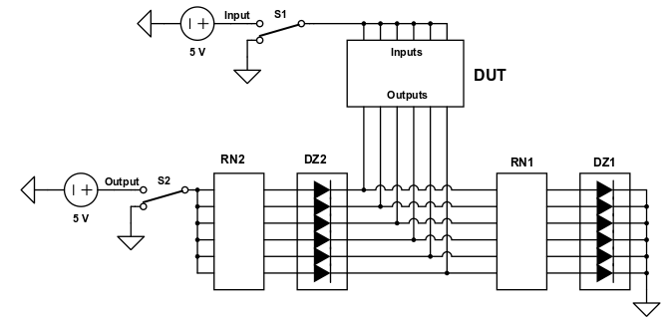
Functionality Testing
The bread board on the left is to test a single hex-inverter
The circuit schematic below is what is on that breadboard
Notes:
David

Slide 15
Functionality Testing
---------------------------------------------------------------------------------------------------------------------------------------------------------------------------------------------
Truth Table
In the table below, 1 means “high” for the switch states, and 1 means conducting for the components.
Switch |  | Diodes |  | Inverter Transistors
“Input” | “Output” | DZ1 | DZ2 | PMOS | NMOS
0 | 0 | 1 | 0 | 1 | 0
0 | 1 | 1 | 0 | 1 | 0
1 | 0 | 0 | 0 | 0 | 1
1 | 1 | 0 | 1 | 0 | 1
Notes:
David

Slide 16
Burn-in Boards
------------------------------------------------------------------------------------------------------------------------------------
Issues
There are two major problems with the existing boards:
Resistor networks in the testing set-up are bussed instead of isolated.
Bussed Resistor Network
Isolated Resistor Network
Notes:
David
Explain difference between bussed and Isolated Resistor Array
There is more than 3000 pins that are already soldered, and would need to be resoldered if we wanted to fix/replace components.

Slide 17
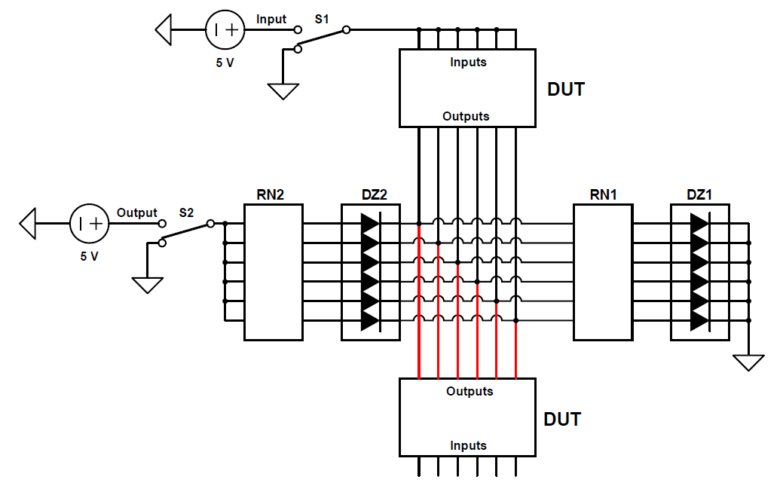
Burn-in Boards
------------------------------------------------------------------------------------------------------------------------------------
Issues
All output gates of each testing setup are connected with other output gates
Notes:
David

Slide 18
Data Analysis
--------------------------------------------------------------------------------------------------------------------------------
General Procedure
Once the lifetimes of the parts have been collected (and a control group that wasn’t stressed) we can pick apart the data.
This will require statistical analysis. After all, no sample is perfectly representative of the parts’ entire population.
Our primary statistic of interest will be the mean lifetimes of the parts.
Notes:
David

Slide 19
Implications
If Latent Damage does exist, it could cause serious issues for the industry.
Conventional repair procedures could be invalid.
ESD affected systems might need to be completely replaced.
Notes:
Jaehyuk
Could lead to reliability issues. Leading to loss of profit. How the latent damage affects industry.

Slide 20
Completed Work
So far, we’ve done the following toward the completion of the project:
Replaced high-voltage source
Began work on establishing a max stress level
Determined issues and intended operation of existing boards
Implemented a single-device testing set-up
Notes:
Hayle

Slide 21
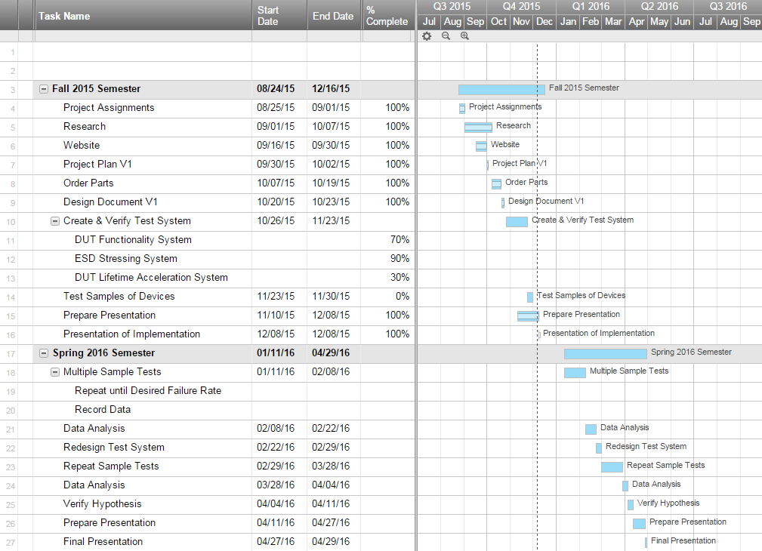
Project Milestones & Schedule
Updated on December 7th, 2015
Notes:
Sean

Slide 22
Next Semester Plans
Establish maximum stress level
Addressing Burn-in PCB issues
Create New PCB Design
Implement new components
Begin Stressing & Burn-in Devices
Test Control Group
Non-stressed devices
Test Experimental Group
Stressed devices at maximum stress level
Analyze Data
Hypothesis Testing
Notes:
Sean

Slide 23
Thank you!
Any Questions?
Notes:
Sean

Slide 24
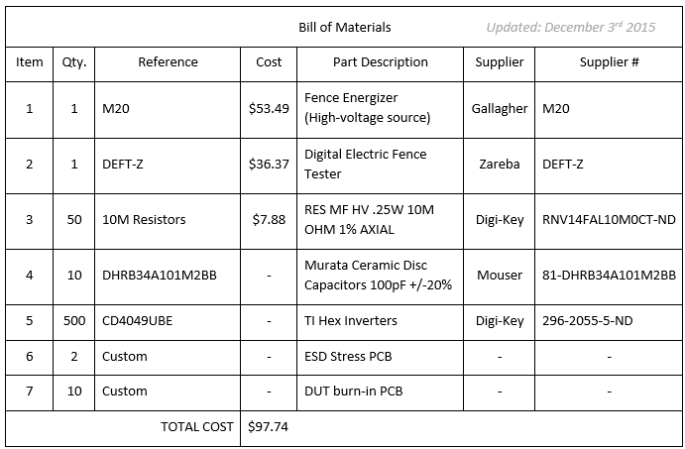
Resource/Cost Estimate
Updated on December 3rd, 2015

Slide 25
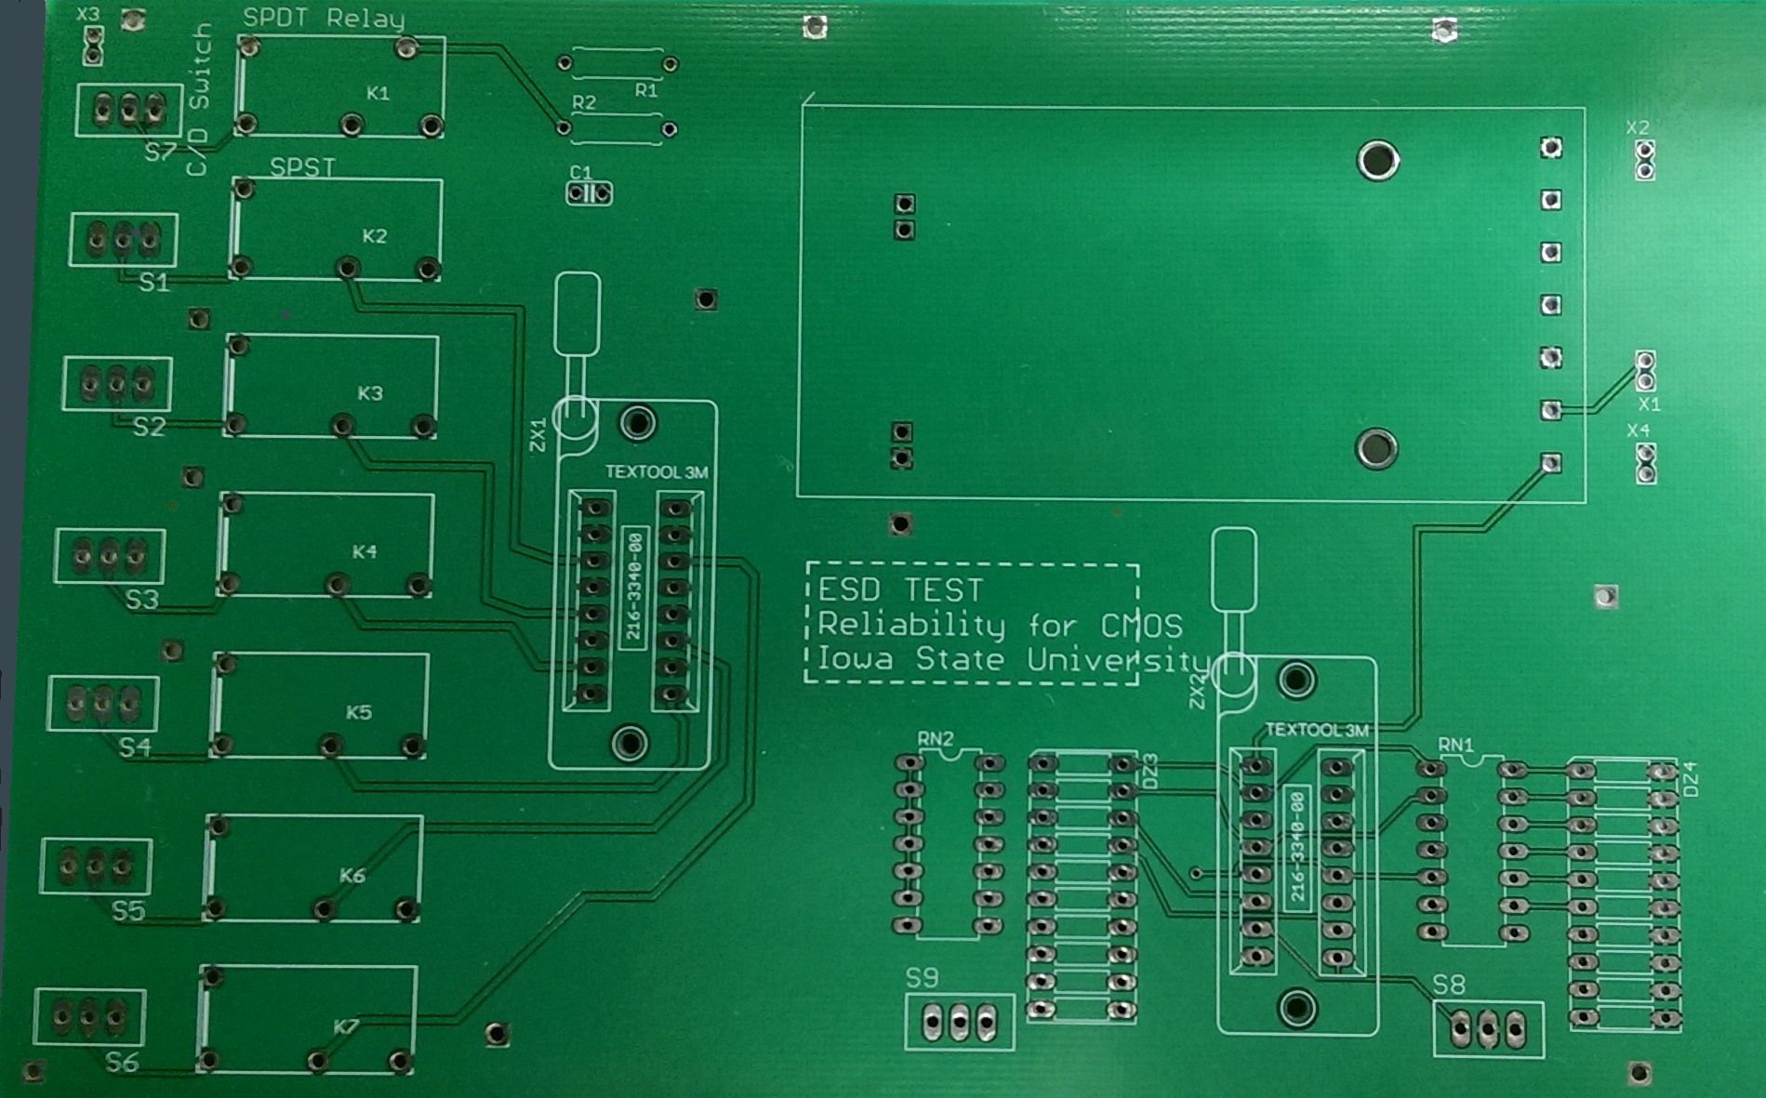
ESD Stress PCB

Slide 26
FIT to MTTF
Arrhenius equation:
k = Ae^{-(Ea/RT)}
k: Boltzmann’s Constant
A: frequency factor/pre-exponential factor
Ea: activation energy (eV)
R: gas constant
T: temperature (in kelvins)
FIT (Failures In Time) to MTTF (Mean Time To Failure)
FIT = λ_{FIT} = λ_{hours} X 10⁹
MTTF_{hours} = 1/λ_{hours}
λ = Failure Rate
Notes:
http://www.microsemi.com/document-portal/doc_view/124041-calculating-reliability-using-fit-mttf-arrhenius-htol-model

